Slide 1
STUDENT INFORMATION MANAGEMENT SYSTEM (SIMS) USING PHP
PAAVAI ENGINEERING COLLEGE(AUTONOMOUS) PACHAL, NAMAKKAL-637 018
GUIDE NAME
Mrs.J.VELUMANI,M.E.,(Ph.D).
Associate Professor
PROJECT MEMBERS
ADITYA PAREEK.V (16104001)
DHINA.S (16104024)
GOBIPRASATH.N (16104029)

Slide 2
ABSTRACT
This webpage can be used by colleges to maintain the records of students easily for placement purpose. This project also contain faculty details, students details in all aspects, the various academic and placement notifications to the staff and students updated by the administration. This project mainly explains the various actions related to student details. This project shows some ease in adding, editing and deleting the student details and it consume less time. This system is focused on recording and updating the student details. It can also facilitate to explore the placement updates for the students with several core companies.

Slide 3
OBJECTIVES
The main objective of this project is to maintain the details of students and staffs. The purpose of Student Information Management System is to get an understanding of how the student’s record is maintained. This Student Information Management System is based on identification some key qualities in the document and their relations. With the understanding of the structure and content of key quality documents, it will help to reduce the duplication and save more time.
The objectives are
Giving online interface for students, staff.
Expanding the effectiveness of college record administration.
Abatement time needed to access and convey students’ records.
To make the framework more secure.

Slide 4
REQUIREMENTS
HARDWARE REQUIREMENTS
System : Intel, AMD Hardwares
Hard Disk : 250 GB.
Monitor : 15 VGA Color.
Mouse : Optical.
RAM : 1 GB
SOFTWARE REQUIREMENTS
Operating system : Platform Independent
Coding Language : HTML, CSS, JS, PHP
Database : My-SQL
Server : Apache
IDE : Notepad++

Slide 5
EXISTING SYSTEM
In the existing system we need to collect the data from the student and the marks will be entered manually.
In this system the teacher or management views, verifies the mark of the students and they enter the details of the students.
This is time consuming and costly.
DISADVANTAGES OF EXISTING SYSTEM
The data can be easily leaked.
There is no efficient technique to safe guard the users of phishing websites.

Slide 6
LITERATURE SURVEY
TITLE&AUTHOR | ADVANTAGE | DISADVANATGE
Development of Student Information System N.M.Z.Hashim, S.N.K.S.Mohamed | Lot of man power and resource time is saved from an admin perspective. | Data can’t be filtered as per the need.
Web Based Student Information Management System S.R.Bharamagoudar, Geeta R.B., S.G.Totad | Redundant human errors will be reduced. | Unauthorized person can easily register.
A Framework for Web Based Student Record Management System using PHP Saurabh Walia1, Satinderjit Kaur Gill | Closer interaction between student and staff. | Consist of single module UI

Slide 7
LITERATURE SURVEY
TITLE&AUTHOR | ADVANTAGES | DISADVANTAGES
Student Information Management System Manisha K, Alekhya K, Manikanta T, Ramya B, Sai Kumar S. | Hassle free recruitment or management for placement companies | Lack of Student personal details.
Student Management System – A Survey Krithi P, Dr M Ramakrishna | Single source of information for students. | Filtering students according to the need of the recruiting companies is difficult.

Slide 8
PROPOSED SYSTEM
In our proposed system we have the provision for adding the details of the students by staff.
Another advantage of the system is that it is very easy to create, edit and modify the student details and delete a student when it found unnecessary.
The marks of the student will be stored in the database and easy to retrieve.

Slide 9
ADVANTAGES OF PROPOSED SYSTEM
Our proposed system has several advantages
User friendly interface
Fast access to database
More Storage Capacity(250GB)
Quick transaction

Slide 10
DATA FLOW DIAGRAM
START
ADMIN HOME
TEACHER HOME
Login fails
LOGIN
LOGIN
Login Success
Login Success
STAFF
STUDENT
CGPA
STUDENT
CGPA

Slide 11
MODULES
User Module
Staff Module

Slide 12
ADMIN MENU
STUDENT INFORMATION MANAGEMENT SYSTEM (SIMS)
ADMIN MENU
GIVES PLACEMENT UPADTE
ADD DEPARTMENT
ADD STAFF
VIEW STAFF
VIEW STUDENT

Slide 13
STAFF MENU
STUDENT INFORMATION MANAGEMENT SYSTEM (SIMS)
STAFF MENU
UPDATE PROFILE
ADD STUDENT
VIEW STUDENT
ADD CGPA
VIEW CGPA
APPLY LEAVE REQUEST

Slide 14
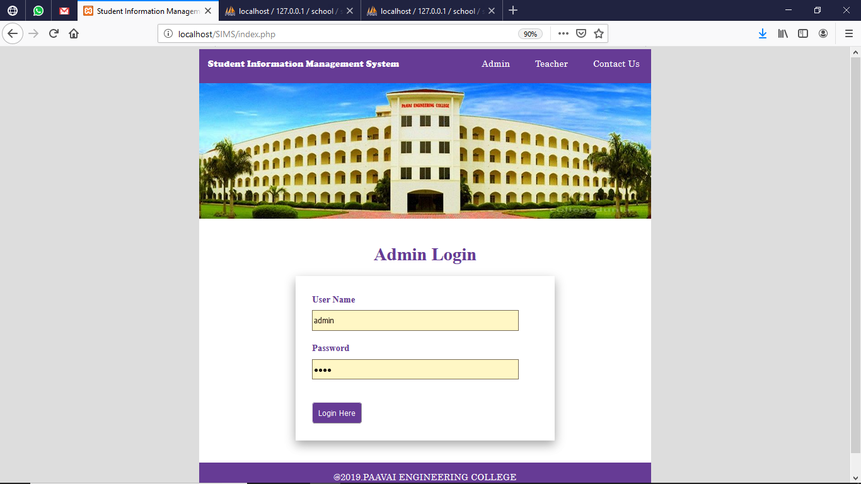
ADMIN LOGIN

Slide 15
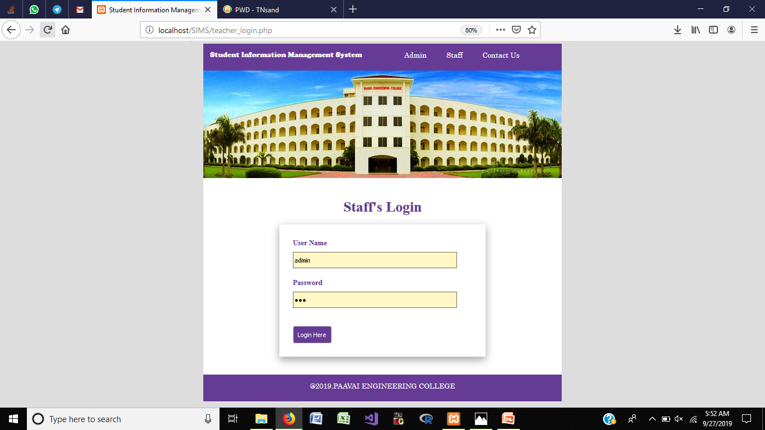
STAFF’S LOGIN

Slide 16
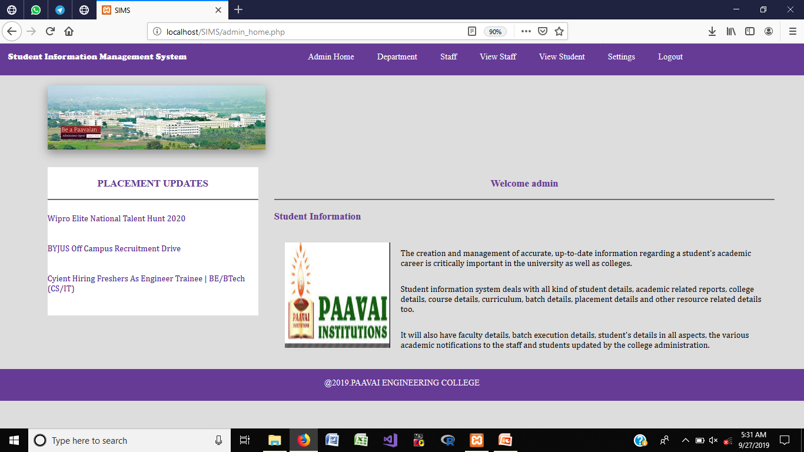
ADMIN HOME PAGE

Slide 17
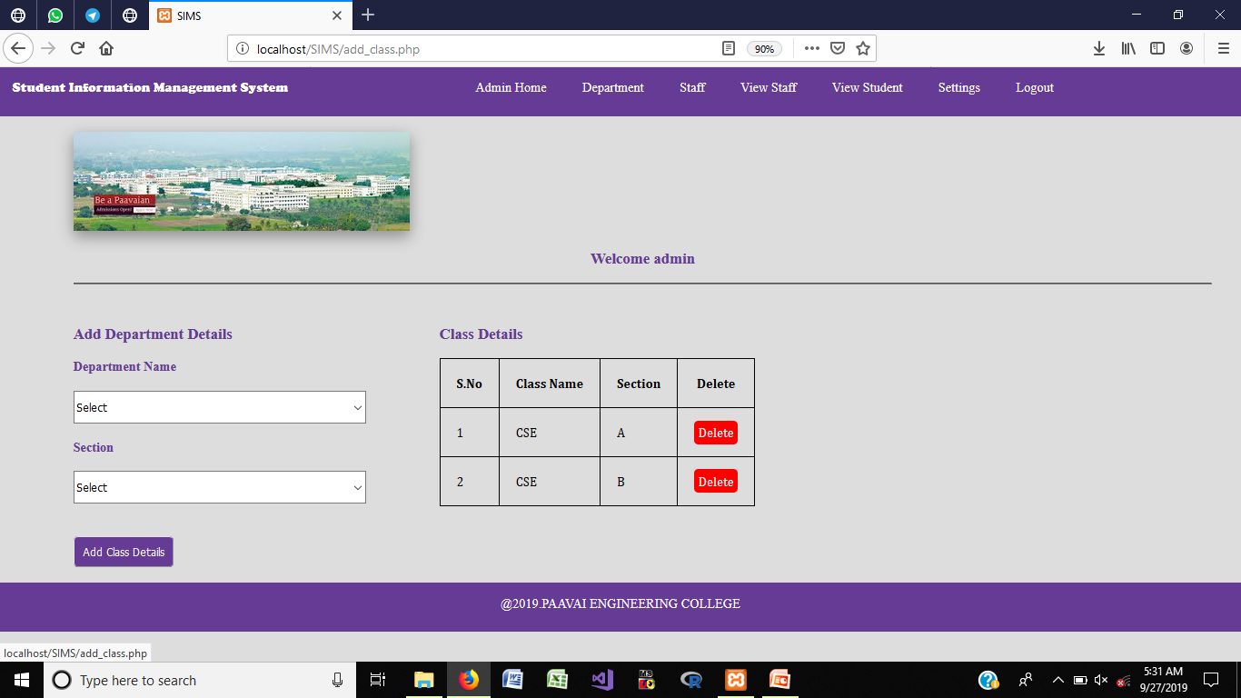
ADD DEPARTMENT

Slide 18
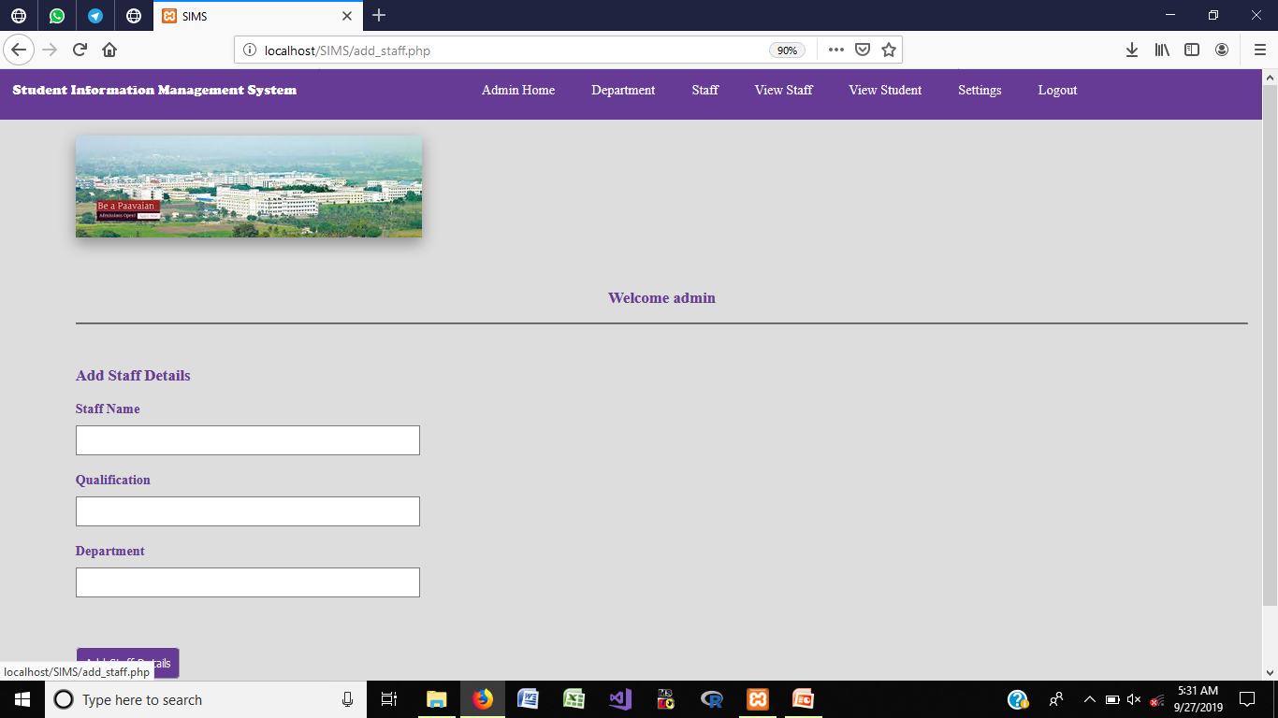
ADD STAFF DETAILS

Slide 19
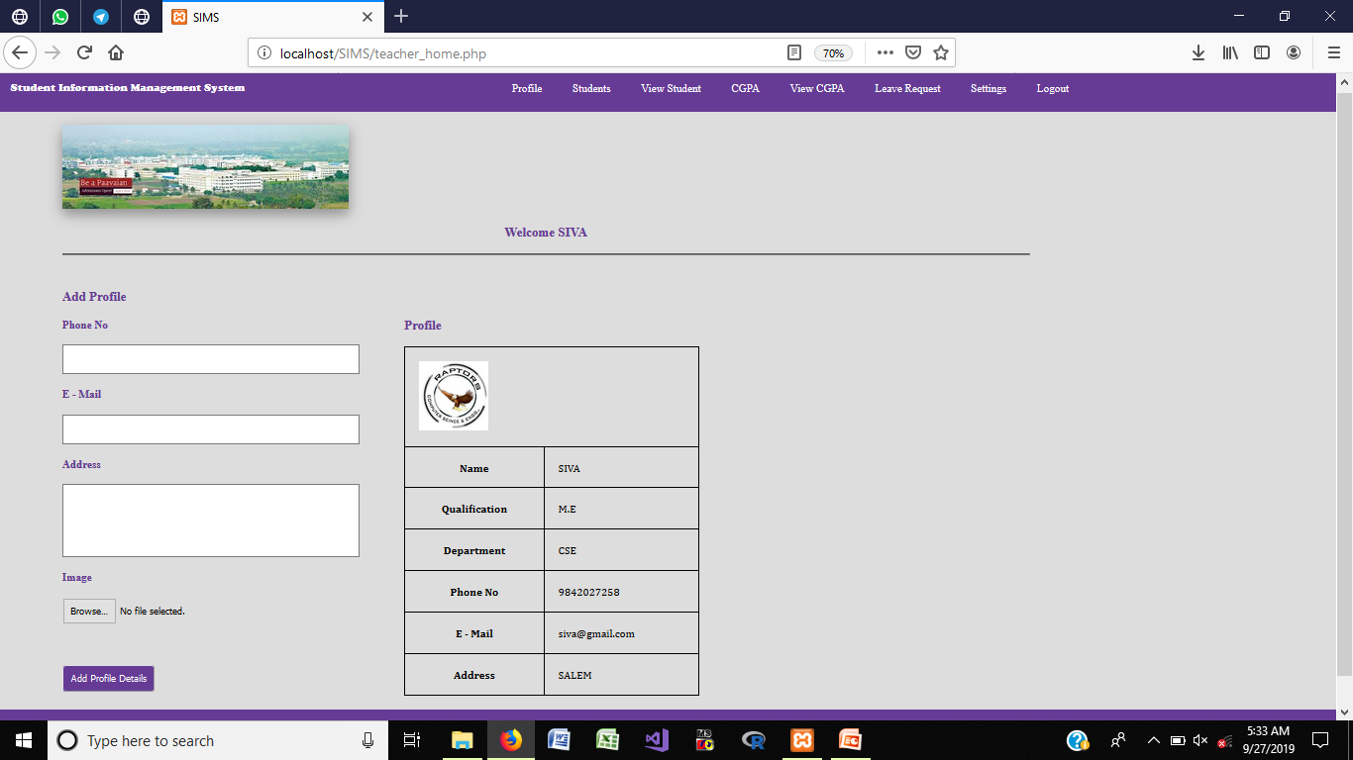
STAFF PROFILE

Slide 20
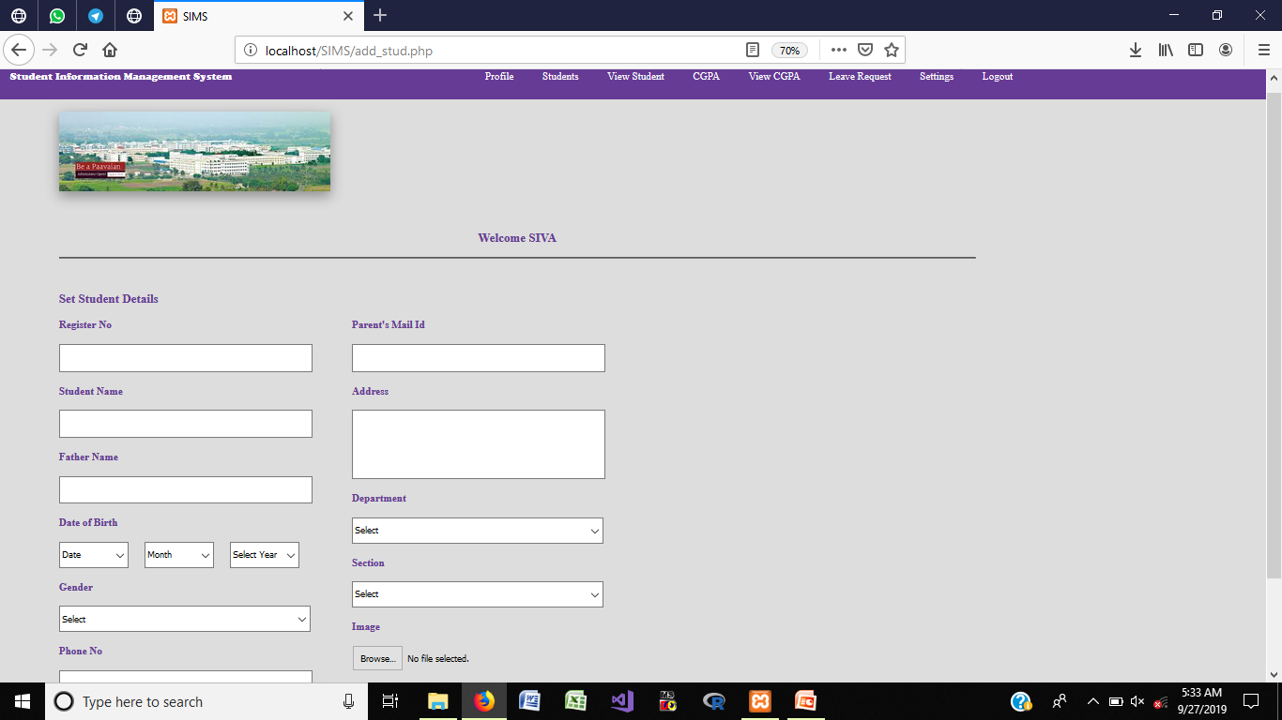
ADD STUDENTS DEATILS

Slide 21
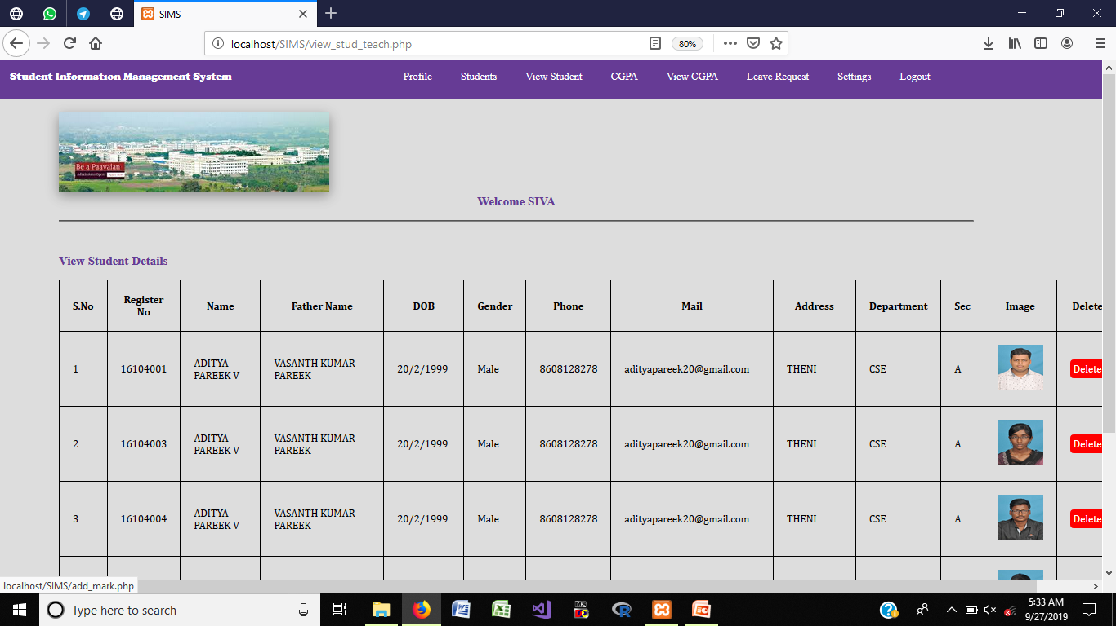
VIEW STUDENTS

Slide 22
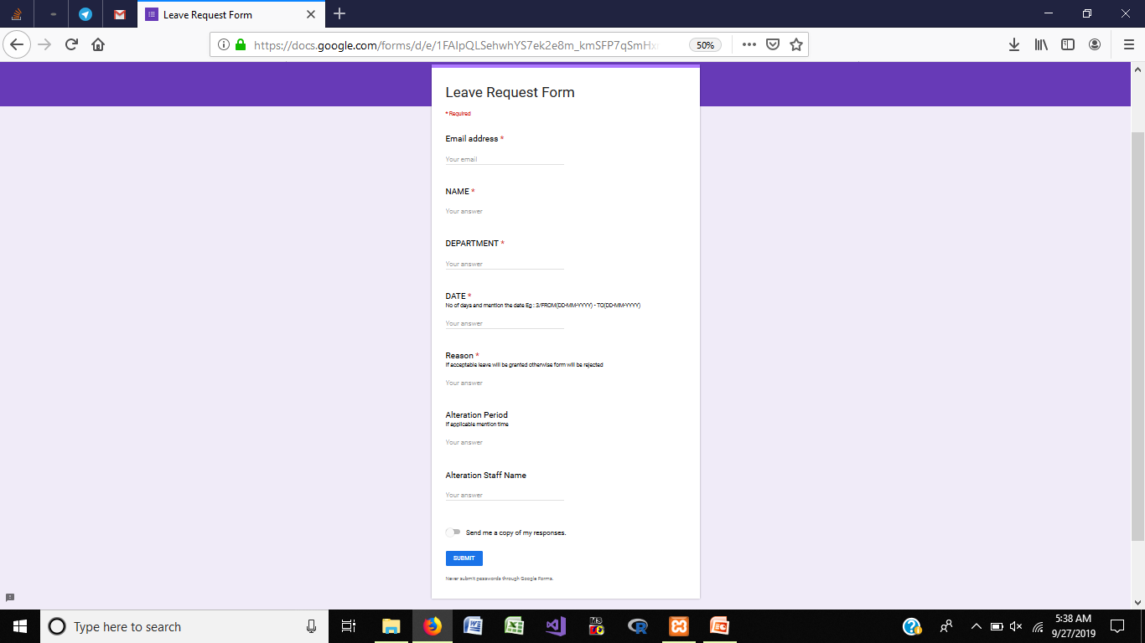
LEAVE REQUEST

Slide 23
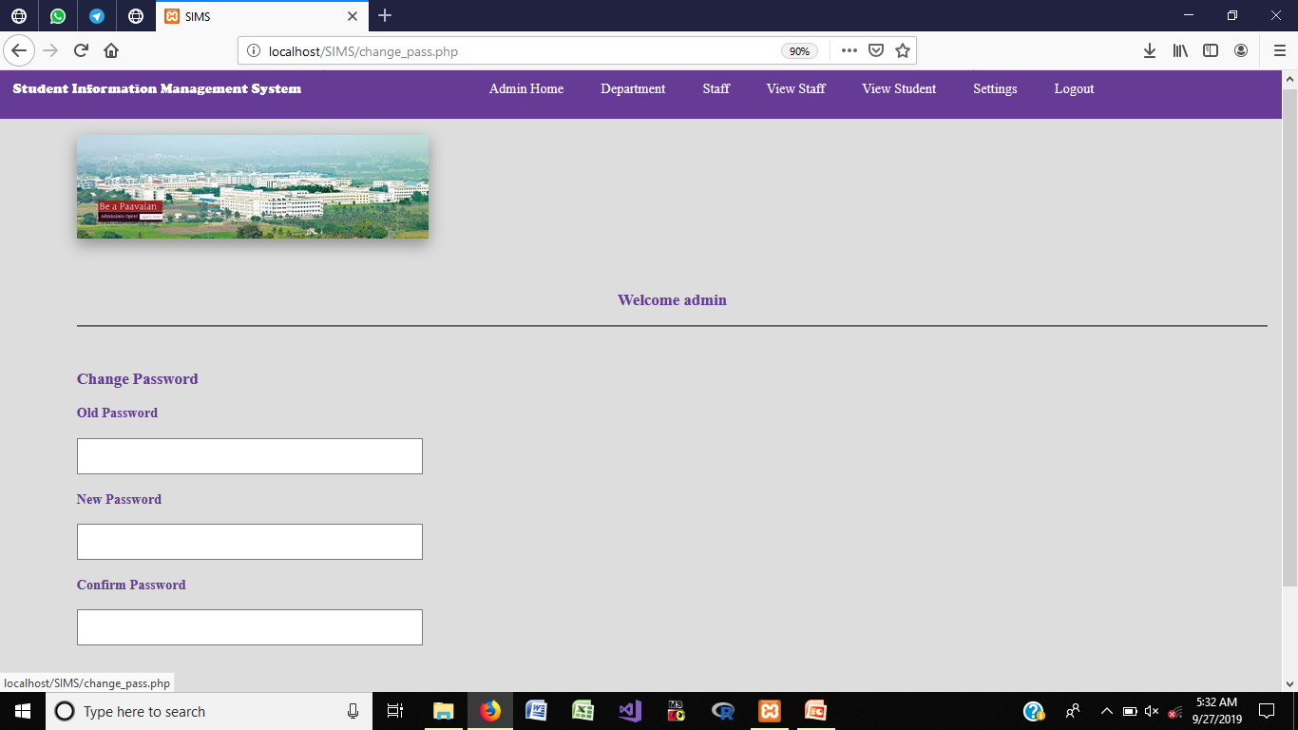
CHANGE PASSWORD

Slide 24
CONCLUSION
Data can be accessed any time.
No wastage of resources in colleges and universities.
Monitored and controlled remotely.
Reduces the man power.
It provides accurate information always.

Slide 25
FUTURE ENHANCEMENT
It can be implemented with additional student data with the strength of whole institution.
It is very easy to get the necessary information without latency. It can be enhanced to get their report on attendance, internal assessments, fees management.
Information about student’s academic performance can be send to their parents via SMS and mail.
The system will be more secure when it is handled by granted users who have the privilege.

Slide 26
REFERENCES
[1] N.M.Z.Hashim, S.N.K.S.Mohamed ”Development of Student Information System” International Journal of Science and Research (IJSR), India Online ISSN: 2319-7064.
[2] S.R.Bharamagoudar, Geeta R.B., S.G.Totad “Web Based Student Information Management System” International Journal of Advanced Research in Computer and Communication Engineering Vol. 2, Issue 6, June 2013.
[3] Saurabh Walia1, Satinderjit Kaur Gill “A Framework for Web Based Student Record Management System using PHP” International Journal of Computer Science and Mobile Computing (IJCSMC), Vol. 3, Issue. 8, August 2014.
Contd…

Slide 27
REFERENCES
[4] Manisha K, Alekhya K, T Manikanta, B Ramya, S. Sai Kumar “Student Information Management System” International Journal of Advanced Research in Computer Science and Software Engineering,Volume 6, Issue 3, March 2016.
[5] Krithi P, Dr M Ramakrishna “Student Management System – A Survey” International Research Journal of Computer Science (IRJCS) Issue 05, Volume 4 (May 2017).

